Slide 1
The Water Cycle

Slide 2
In this Smart Lesson, you will learn how the water cycle works and why it is threatened by human activity.
• Explain how water is recycled through the four spheres of Earth.
• Identify how water changes states as it is recycled.
• Describe the consequences of human activity on the water cycle.

Slide 3

Did you know that 71% of the Earth's surface is covered in water? Water is found in things like oceans, rivers and lakes, as well as in the atmosphere. However, no new water ever enters the Earth.
This is because all the water on Earth is naturally recycled over thousands of years in a process known as the water cycle!

Slide 4
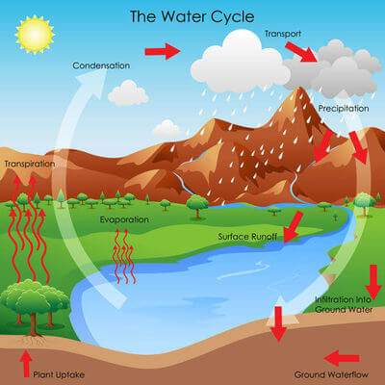
The water cycle is a process that describes how water is recycled through the four spheres of Earth.
The water cycle is a closed system. This means that there is no change in the amount of material in the system - no water can ever be added or removed.

Slide 5
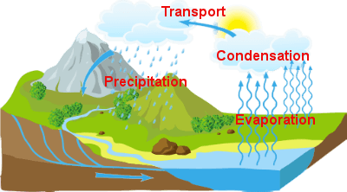
The Sun heats the liquid water found in oceans, rivers and lakes, causing it to evaporate and form water vapour.
As the water vapour rises, the air temperature decreases. This causes the water vapour to lose heat energy and condense to form clouds.

Slide 6
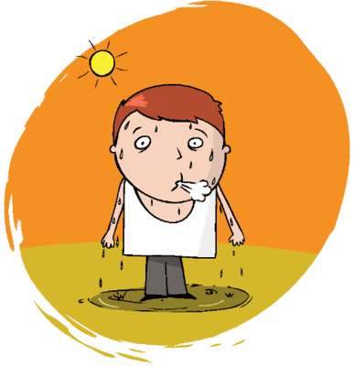
Humidity is a measure of the amount of water vapour in the air. Humidity levels are directly influenced by the water cycle!
When liquid water evaporates, it becomes gaseous water vapour. When evaporation rates are high, the humidity increases.

Slide 7
When the air temperature is low enough, water vapour condenses to form clouds. However as the temperature continues to drop, the air's ability to hold water vapour also decreases.
When the mass of the water vapour (clouds) becomes too much for the cool air, the water vapour falls to Earth's surface as large droplets of liquid water known as rain.
Any water falling from the clouds, whether solid or liquid, is known as precipitation.

Slide 8
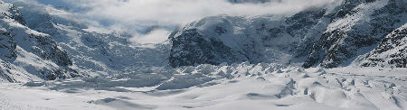
In cold areas, the water can fall as hail, sleet or snow. In some places it is then stored in snow drifts or glaciers.
Water can remain stored here for a very long time before re-entering the water cycle.

Slide 9
When precipitation falls on land it is either absorbed or not absorbed by the soil.
Runoff occurs when the water is not absorbed into the ground. Instead, the water flows across the ground into a lake, river or ocean. Runoff can cause erosion due to its ability to remove soil and rock from one location and carry it to another.

Slide 10
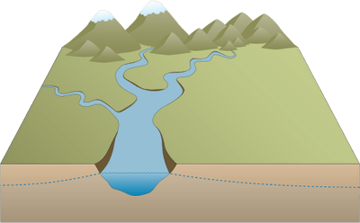
Infiltration occurs when water is absorbed by the soil.
The water can sink so far into the ground that it enters the water table, which is an area below the ground that is saturated with water. This process is known as percolation.

Slide 11
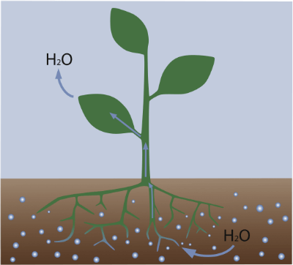
If the water is absorbed by plant roots, it will escape through the leaves of the plant as water vapour. This process is called transpiration.

Slide 12


Slide 13
Humans interrupt the water cycle in multiple ways, which can affect biodiversity and water availability.
We burn fossil fuels, we chop down trees, we pave over soil and we pollute the small amount of freshwater we have available to us!

Slide 14
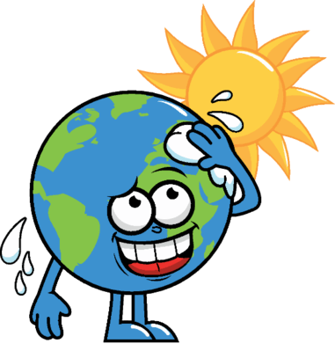
The burning of fossil fuels and release of greenhouse gases warms the planet by trapping heat in the atmosphere. This causes the air temperature to rise, leading to increased rates of evaporation and amount of water vapour that can be stored in the atmosphere.

Slide 15
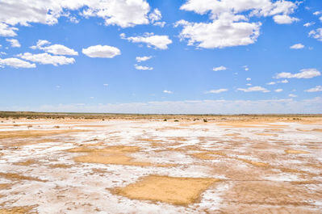
Higher rates of evaporation can cause intense rain and extreme weather patterns near bodies of water.
However, in dry areas where there is little water to evaporate, drought conditions can become more common. In dry areas, water is evaporated quickly and stored in the atmosphere rather than being precipitated. Drought conditions lead to dry soil and rapid evaporation of small bodies of water, which in turn reduces the number of plants and animals that can survive.

Slide 16
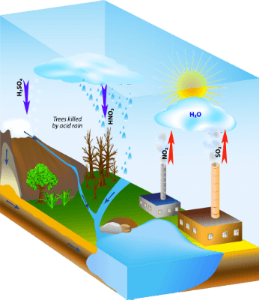
Burning certain fossil fuels can cause sulfur and nitrogen compounds to be released into the atmosphere.
These compounds are able to combine with water vapour and make it more acidic. When this water vapour is precipitated, it is known as acid rain.

Slide 17
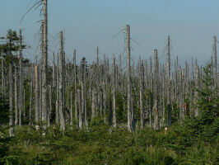
When acid rain reaches the Earth's surface, it can cause water bodies such as rivers, lakes and oceans to become more acidic.
Biodiversity can be directly impacted in areas where acid rain is common. Organisms that are unable to tolerate the increased acidity will not survive. Removing even one species from a food web can have catastrophic effects on biodiversity.

Slide 18
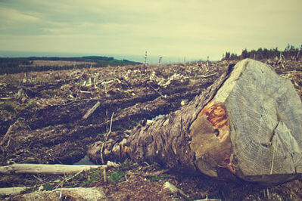
Deforestation reduces the amount of trees in an area, which leads to a reduced amount of transpiration. For this reason, deforestation can reduce the amount of water vapour in the atmosphere and result in reduced rainfall.

Slide 19
When trees are cut down, less water from the soil is able to make its way back to the atmosphere. This lowers the amount of rainfall in the surrounding areas and can lead to drought.
Drought can kill off water-reliant plants, and the animals that rely on those plants for food, reducing an ecosystem's biodiversity.

Slide 20
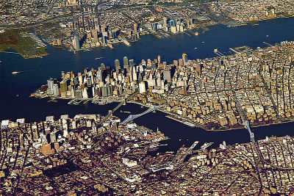
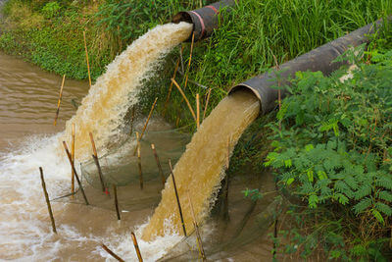
Urbanisation, or the building of cities, has led to much of Earth's soil being covered in pavement, tarmac or buildings.
This makes the ground impermeable to water, meaning it can no longer soak up rain when it falls. The rate of infiltration is reduced and the possibility of flooding increases, because all water from cities is carried to rivers instead of infiltrating the soil.

Slide 21
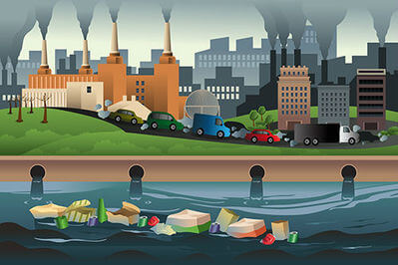
The amount of water within the water cycle is unchanging but our use of freshwater is constantly increasing. Pollution of freshwater sources can have severe effects on human wellbeing and the environment.
Fertilisers, plastics, human or animal waste, oil and other pollutants can enter rivers and lakes, decreasing our very small store of drinkable and usable freshwater. They can also kill the organisms living in and around the water source, reducing the biodiversity of the ecosystem.

